Slide 1
A depth-controlled and energy-efficient routing protocol for underwater wireless sensor networks
Presented
by
BATCH NO: XX
1.Name 21NG1A04XX
2.Name 21NG1A04XX
3.Name 21NG1A04XX
UNDER THE ESTEEMED GUIDANCE OF
Guide Name, Qualification
Designation
DEPARTMENT OF ELECTRONICS AND COMMUNICATION ENGINEERING

Slide 2
CONTENTS
ABSTRACT
INTRODUCTION
LITERATURE SURVEY
EXISTING SYSTEM
EXISTING SYSTEM BLOCK DIAGRAM
EXISTING SYSTEM DRAWBACKS
PROPOSED SYSTEM NECESSITY(Problem Identification)
PROPOSED SYSTEM BLOCK DIAGRAM
PROPOSED SYSTEM EXPLANATION/DESCRIPTION
PROJECT REQUIREMENTS
a) SOFTWARE
11.ADVANTAGES
12.APPLICATIONS
13.CONCLUSIONS
REFERENCES

Slide 3
ABSTRACT
This project is to design a routing protocol for underwater sensor nw
a depth controlled with energy-balanced routing protocol, which will be able to adjust the depth of lower energy nodes and be able to swap the lower energy nodes with higher energy nodes to ensure consistent energy utilization.
The proposed energy-efficient routing protocol is based on an enhanced genetic algorithm and data fusion technique. In the proposed energy-efficient routing protocol, an existing genetic algorithm is enhanced by adding an encoding strategy, a crossover procedure, and an improved mutation operation that helps determine the nodes.

Slide 4
INTRODUCTION
Ocean observing is essential for a better understanding of how society and all life on earth is affected by climate change.
Information from ocean observing is also essential for weather forecasting.
It delivers early warning of hazards like tsunamis, storm surges and extreme waves that helps save lives and enables marine operators to remain efficient. Water or oceans nearly covers the 70 percent of the earth’s total area but, more than 80 percent of these areas are unmapped and unexplored.

Slide 5
predictive and preemptive cross-layer protocol( CLPP)
vector based forwarding protocol (VBF)
Packet Delivery Ratio(PDR)
Genetic Algorithm with Hill climbing (GAHC)
energy-efficient clustering multi-hop routing protocol (EECMR)
depth-based routing (DBR)
Grey Wolf Optimization (GWO)
Advocates of Linux Open-source Hawaii Association (ALOHA)
Secure Energy Efficient and Cooperative Routing protocol (SEECR)
(AMCTD) Adaptive Mobility of Courier Nodes in Threshold-optimized DBR

Slide 6
LITERATURE SURVEY
S.NO | TITLE | YEAR OF PUBLISH | TECHNIQUES | PARAMETERS | ADVANTAGES
1 | A Cross-Layer Predictive and Preemptive Routing Protocol for Underwater Wireless Sensor Networks Using the Lagrange Interpolation | 2021 | CLPP VBF | Energy Consumption, Avg. End to End delay, No. of nodes, PDR | Deployed for a large scale nw, No loss of connectivity, No link failure problems, More PDR, Reduced Delay
2 | An Improved Hybrid Secure Multipath Routing Protocol for MANET | 2021 | GAHC for MANET | PDR, Throughput, Detection rate, Energy consumption | More security, multipath routing, multi-hop routing, minimum amount of energy
3 | Energy-Efficient Clustering Multi-Hop Routing Protocol in a UWSN | 2021 | EECMR FOR UWSNs | Received Packets at sink, Transmission range, Nodes count, Residual energy | Energy efficient, Les residual energy, Less dead nodes, Long network life, More PDR

Slide 7
LITERATURE SURVEY
S.NO | TITLE | YEAR OF PUBLISH | TECHNIQUES | PARAMETERS | ADVANTAGES
4 | An Improved Efficient Bandwidth Allocation using TCP Connection for Switched Network | 2021 | CLPP VBF | Bandwidth Delay Packet Loss | high – speed, Less bandwidth More robust
5 | Underwater Acoustic Sensor Networks: An Energy Efficient and Void Avoidance Routing Based on Grey Wolf Optimization Algorithm | 2021 | DBR GWO | Avg. End to End Delay, Avg Hopes, Dead nodes, Energy consumption, Time | energy efficient, Less residual energy, Less hop count, More link quality
6 | Buffering_Slotted_ALOHA protocol for underwater acoustic sensor networks based on the slot status | 2021 | Buffering_Slotted_ALOHA protocol | Average delay Energy consumption Dropped nodes Throughput | Low energy consumption, Low average delay dropped nodes, and More throughput rate.

Slide 8
LITERATURE SURVEY
S.NO | TITLE | YEAR OF PUBLISH | TECHNIQUES | PARAMETERS | ADVANTAGES
7 | A routing-benefited deployment approach combining static and dynamic layouts for underwater optical wireless networks | 2021 | Underwater optical wireless communication model, VBF (vector-based forwarding) protocol | Avg Time delay, Number of nodes, Packet-loss rate, Residual energy | reliable communication, Efficietn coverage, Less energy, and routing performances
8 | SEECR: Secure Energy Efficient and Cooperative Routing Protocol for Underwater Wireless Sensor Networks | 2020 | SEECR, AMCTD DBR | End-to-end delay, Energy, Throughput, Transmission loss, No. of Alive Nodes | Low energy consumption, built-in defense mechanism
9 | Blockchain: A New Technology to Enhance Data Security and Privacy in Internet of Things | 2020 | BLOCKCHAIN TECHNOLOGY | Reliablity, Data Storage, | More secure infrastructure, Parallelism

Slide 9
LITERATURE SURVEY
S.NO | TITLE | YEAR OF PUBLISH | TECHNIQUES | PARAMETERS | ADVANTAGES
10 | Advancement of Routing Protocols and Applications of Underwater Wireless Sensor Network (UWSN): A Survey | 2020 | Two dimensional UWSN architecture using Dive and Rise (DNR) method | Delivery Ratio, Energy Efficiency, Reliability, Delay Efficiency | Energy efficient, Works at harsh environment, Low path loss and High data rate

Slide 10
Drawbacks
1: More energy is consumes at a highest speed level, More energy at rediscovering phase.
2: packet dropping occurs , Huge latency, can’t work for larger nodes
3: optimization of the network
4: More energy consumption, Can’t work for mobile nodes,
5:Can’t work for mobile devices like unmanned aerial vehicles (UAVs) and unmanned underwater vehicles (UUVs).
6: time and space complexity still exists, low security
7: environmental factors need to be considered, can’t work for practical application.
8: secure solutions for only UWSNs, Low range communication
9 : Not adaptable, Attackers can destroy data, More complex
10: More bit error rate, More hardware cost, Low packet delivery ratio.

Slide 11
EXISTING SYSTEM
Energy efficient depth-based routing algorithm (EEDBR)
proposed protocol utilizes the depth of the sensor nodes for forwarding the data packets. Furthermore, the residual energy of the sensor nodes is also taken into account in order to improve the network life-time.
Each sender transmits the data packet including a list of its neighbors’ IDs, which contains only the IDs of the neighbors having smaller depths than the sender. Hence, only the selected neighboring nodes are eligible to forward the packet

Slide 12
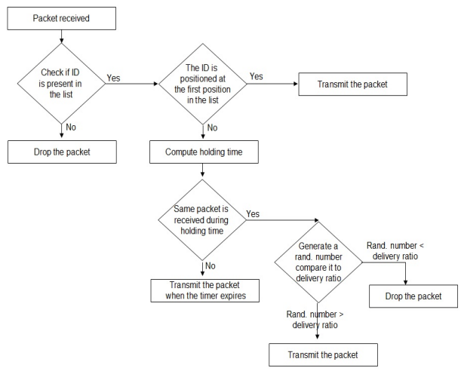
Existing flow

Slide 13
Drawbacks
1. Total energy consumption is still huge
2. Low packet delivery ratio
3. Some packet loss
4. Low network life time

Slide 14
Problem Identification
When ever nodes arrangement is complex in nature, updating their location or adding new devices is pretty challenging, then there is no such efficient network for that WSN.
Where there is no chance of replacing Batteries , that WSN need to work with low residual energy with low latency and More reliability. So there is no such WSN protocol to satisfy above requirements.

Slide 15
Proposed method
Depth-controlled and energy-efficient routing protocol (DCEER) for UWSN

Slide 16
PROPOSED SYSTEM & IT’S WORKING
EEP & EGA
Energy Efficient routing Protocol
Eenhanced genetic algorithm
two phases: routing and data transmission.
EEP: to search for the best possible multi-hop path ways among the sender and receiver nodes.
EGA method encrypts routing pathways as chromosomes and all the participating nodes as genes.

Slide 17
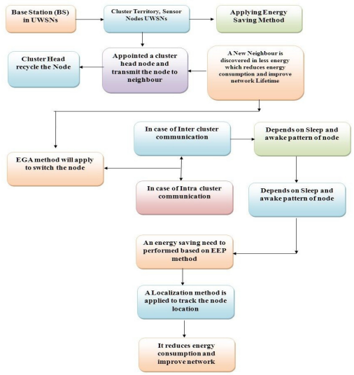

Slide 18
Step 1: base station keeps track of UWSN’s sensor devices and creates cluster neighborhoods.
Step 2: Using the proposed EEP strategy, each cluster territory obtains information from cluster members. This method accepts each independent node’s energy condition when transmitting data. At the same time, a large portion of the portable sensor clusters is placed into standby mode.
Step3: cluster endpoints are chosen from every team of cluster territories. The Neighbor Discovery Methodology is used to establish head-to-head connectivity
Step4: Once new digital endpoints arrive or are relocated, this method predicts the accepted nodes and the cluster territories.

Slide 19
Step 5: Sensor nodes are switched from one position to combine information over the network utilizing GA after composting each cluster group and newly appointed Cluster nodes in each cluster territory.
Step 6: Protocol extracting the energy level at each cluster community and rebalancing the cluster end points is universally recognized as the most straight forward way. After that, they anticipate the base station condition beyond passing to the dead battery scenario to drop through the Energy Scheduling strategy in the system.

Slide 20

Number of participants
number of participants nodes Np when data transferred from source to destination
private network radial distance NR,
node density ND,
width of each circle sector RingW,
max limit of hops MaxH

Slide 21
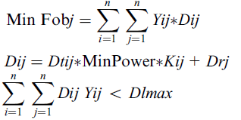
Best path
Sink Node =final destination.
source node is the CHN which requires transferring information.
Using objective formula (Fobj) going to find best path
Yij= connection indication
Dij= connection cost of energy
Eij=connection latency
Kij=duration,
Dlmax =maximal delay of the route
Along with number of participants also

Slide 22
Encoding phase in EGA
origin node, target node
Path information is stored
along with transmitted data.
Path info is encoded using
following seq
(S.N, DU.N, S.N,T.N,LB.N,L.N……….D.N)

Slide 23
SOFTWARE
MATLAB 2013-2020
WINDOWS 8/10/11

Slide 24
ADVANTAGES
1. Low network transmission loss
2. More network throughput
3. More live nodes
4. Low packet loss
5. More security

Slide 25
APPLICATIONS
Oceanology
Surveillance and Monitoring for security, threat detection
Environmental temperature, humidity, and air pressure
Landslide Detection

Slide 26
Conclusion
For the purpose of literature review, we have downloaded almost 15 papers, in those 10 are selected to prepare literature survey. Me and my batch mates have studied them to tabulate as shown in above format.
A brief of Existing and proposed methods are studied along with existing method drawbacks.

Slide 27
References
Umesh Kumar Lilhore1 , Dr. Osamah Ibrahim Khalaf2, Sarita Simaiya3, “A depth-controlled and energy-efficient routing protocol for underwater wireless sensor network” Advanced Software and Data Processing for Mobile Underwater Sensory Networks 2022
1. Ahmed B, Cherif MA and Hacene SB. A cross-layer predictive and preemptive routing protocol for underwater wireless sensor networks using the Lagrange interpolation. Int J Wirel Netw Broadband Technol 2021; 10(2): 78–99.
2. Srilakshmi U, Veeraiah N, Alotaibi Y, et al. An improved hybrid secure multipath routing protocol for MANET. IEEE Access 2021; 11(2): 114–127.
3. Nguyen NT, Le TTT, Nguyen HH, et al. Energy-efficient clustering multi-hop routing protocol in a UWSN. Sensors 2021; 21(2): 627–627.
4. Osamah I and Khalaf G. An improved efficient bandwidth allocation using TCP connection for switched network. J Appl Scie Eng 2021; 24(5): 1056–1068.
5. Gola KK and Gupta B. Underwater acoustic sensor networks: an energy efficient and void avoidance routing based on grey wolf optimization algorithm. Arab J Sci Eng 2021; 46(4): 3939–3954.

Slide 28
6. Khater E, El-Fishawy N, Tolba M, et al. Buffering_Slotted_ ALOHA protocol for underwater acoustic sensor networks based on the slot status. Wirel Netw 2021; 27(5): 3127–3145
7. Shen Z, Yin H, Liang Y, et al. A routing-benefited deployment approach combining static and dynamic layouts for underwater optical wireless networks. Int J Distrib Sens Netw 2021; 17(2): 15501–15531.
8. Saeed K, Khalil W, Ahmed S, et al. SEECR: secure energy efficient and cooperative routing protocol for underwate wireless sensor networks. IEEE Access 2020; 8: 107419107433.
9. Simaiya S, Lilhore UK, Sharma SK, et al. Blockchain: a new technology to enhance data security and privacy in Internet of things. J Comput Theor Nanosci 2020; 17(6): 2552–2556.
10. Haque KF, Kabir KH and Abdelgawad A. Advancement of routing protocols and applications of underwater wireless sensor network (UWSN)-a survey. J Sens Actuator Netw 2020; 9(2): 19–31.

